Slide 1
MITOSIS

Slide 3
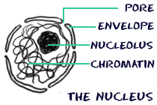
The things that make a eukaryotic cell are a defined nucleus and other organelles. The nuclear envelope surrounds the nucleus and all of its contents. The nuclear envelope is a membrane similar to the cell membrane around the whole cell. There are pores and spaces for RNA and proteins to pass through while the nuclear envelope keeps all of the chromatin and nucleolus inside.

Slide 4
 | Cell Nucleus - Commanding the Cell The cell nucleus acts like the brain of the cell. It helps control eating, movement, and reproduction. If it happens in a cell, chances are the nucleus knows about it. The nucleus is not always in the center of the cell. It will be a big dark spot somewhere in the middle of all of the cytoplasm (cytosol). You probably won't find it near the edge of a cell because that might be a dangerous place for the nucleus to be. If you don't remember, the cytoplasm is the fluid that fills cells.

Slide 5
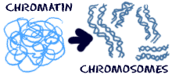
When the cell is in a resting state there is something called chromatin in the nucleus. Chromatin is made of DNA, RNA, and nuclear proteins. DNA and RNA are the nucleic acids inside of the cell. When the cell is going to divide, the chromatin becomes very compact. It condenses. When the chromatin comes together, you can see the chromosomes. You will also find the nucleolus inside of the nucleus. When you look through a microscope, it looks like a nucleus inside of the nucleus. It is made of RNA and protein. It does not have much DNA at all.

Slide 6
Mitosis is the process by which a eukaryotic cell separates the chromosomes in its cell nucleus into two identical sets, in two separate nuclei. It is generally followed immediately by cytokinesis, which divides the nuclei, cytoplasm, organelles and cell membraneinto two cells containing roughly equal shares of these cellular components. Mitosis and cytokinesis together define the mitotic (M) phase of the cell cycle—the division of the mother cell into two daughter cells, genetically identical to each other and to their parent cell. This accounts for approximately 10% of the cell cycle.

Slide 7
The process of mitosis is fast and highly complex. The sequence of events is divided into stages corresponding to the completion of one set of activities and the start of the next. These stages are prophase, prometaphase, metaphase,
anaphase and telophase. During mitosis the pairs of chromatids condense and attach to fibers that pull the sister chromatids to opposite sides of the cell. The cell then divides in cytokinesis, to produce two identical daughter cells which are still diploid cells.

Slide 8
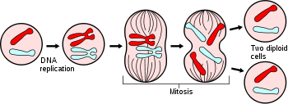

Slide 9
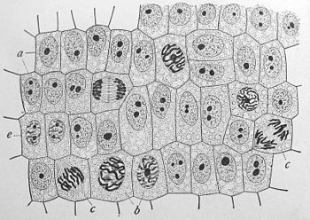

Slide 10
Because cytokinesis usually occurs in conjunction with mitosis, "mitosis" is often used interchangeably with "mitotic phase". However, there are many cells where mitosis and cytokinesis occur separately, forming single cells with multiple nuclei. This occurs most notably among the fungi and slime moulds, but is found in various groups. Even in animals, cytokinesis and mitosis may occur independently, for instance during certain stages of fruit fly embryonic development. Errors in mitosis can either kill a cell through apoptosis or cause mutations that may lead to certain types of cancer.

Slide 11
CELL-CYCLE

Slide 12
The cell cycle, or cell-division cycle, is the series of events that take place in a cell leading to its division and duplication (replication). In cells without a nucleus (prokaryotic), the cell cycle occurs via a process termed binary fission.

Slide 13
In cells with a nucleus (eukaryotes), the cell cycle can be divided in two periods: interphase—during which the cell grows, accumulating nutrients needed for mitosis and duplicating its DNA—and the mitosis (M) phase, during which the cell splits itself into two distinct cells, often called "daughter cells"

Slide 14
and the final phase, cytokinesis, where the new cell is completely divided.
*The cell-division cycle is a vital process by which a single celled fertilized egg develops into a mature organism, as well as the process by which hair, skin, blood cells, and some internal organs are renewed.

Slide 15
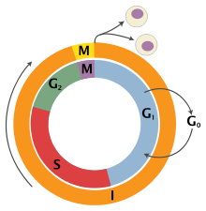
Phases of cell cycle and mitosis
Interphase
The cell cycle
The mitotic phase is a relatively short period of the cell cycle. It alternates with the much longer interphase, where the cell prepares itself for cell division. Interphase is divided into three phases: G₁ (first gap), S (synthesis), and G₂ (second gap). During all three phases, the cell grows by producing proteins and cytoplasmic organelles. However, chromosomes are replicated only during the S phase. Thus, a cell grows (G₁), continues to grow as it duplicates its chromosomes (S), grows more and prepares for mitosis (G₂), and finally it divides (M) before restarting the cycle. All these phases in the interphase are highly regulated, mainly via proteins. The phases follow one another in strict order and there are "checkpoints" that give the cell the cues to proceed from one phase to another. There is also a fourth section in Interphase where the cell has the option to enter G₀. Cells continue on through this cell cycle until they become too crowded; at that point they will exit the cell cycle and enter G₀. This reaction is called contact inhibition or density-dependent inhibition. Altogether interphase takes up roughly 90% of a cell's lifespan.

Slide 16
Phases
The cell cycle consists of four distinct phases: G₁ phase, S phase (synthesis), G₂ phase (collectively known as interphase
and M phase (mitosis).
*M phase is itself composed of two tightly coupled processes: mitosis, in which the cell's chromosomes are divided between the two sister cells, and cytokinesis, in which the cell's cytoplasm divides in half forming distinct cells.
Activation of each phase is dependent on the proper progression and completion of the previous one.
*Cells that have temporarily or reversibly stopped dividing are said to have entered a state of quiescence called G₀ phase.

Slide 18
State | Description | Abbreviation
quiescent/ senescent | Gap 0 | G₀ | A resting phase where the cell has left the cycle and has stopped dividing.
Interphase | Gap 1 | G₁ | Cells increase in size in Gap 1. TheG₁ checkpoint control mechanism ensures that everything is ready for DNA synthesis.
 | Synthesis | S | DNA replication occurs during this phase.
 | Gap 2 | G₂ | During the gap between DNA synthesis and mitosis, the cell will continue to grow. The G₂ checkpoint control mechanism ensures that everything is ready to enter the M (mitosis) phase and divide.
Cell division | Mitosis | M | Cell growth stops at this stage and cellular energy is focused on the orderly division into two daughter cells. A checkpoint in the middle of mitosis (Metaphase Checkpoint) ensures that the cell is ready to complete cell division.

Slide 19
After cell division, each of the daughter cells begin the interphase of a new cycle. Although the various stages of interphase are not usually morphologically distinguishable, each phase of the cell cycle has a distinct set of specialized biochemical processes that prepare the cell for initiation of cell division.

Slide 20
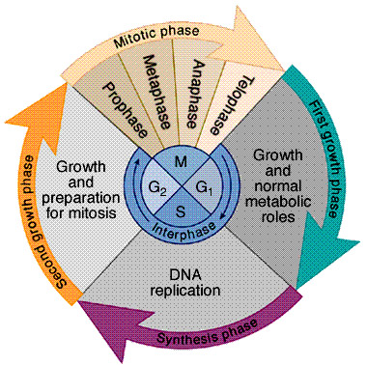

Slide 21
Resting (G₀ phase)
The term "post-mitotic" is sometimes used to refer to both quiescent and senescent cells. Nonproliferative cells in multicellular eukaryotes generally enter the quiescent G₀ state from G₁ and may remain quiescent for long periods of time, possibly indefinitely (as is often the case for neurons). This is very common for cells that are fully differentiated. Cellular senescence occurs in response to DNA damage or degradation that would make a cell's progeny nonviable; it is often a biochemical reaction; division of such a cell could, for example, become cancerous. Some cells enter the g0 phase semi-permanentally e.g., some liver and kidney cells.

Slide 22
Interphase
Before a cell can enter cell division, it needs to take in nutrients. All of the preparations are done during the interphase. Interphase proceeds in three stages, G1, S, and G2. Cell division operates in a cycle. Therefore, interphase is preceded by the previous cycle of mitosis and cytokinesis. Interphase is also known as preparatory phase, in this stage nucleus and cytosol division does not occur.The cell prepares to divide.

Slide 23
G₂ phase
The cell then enters the G₂ phase, which lasts until the cell enters mitosis.
* Again, significant biosynthesis occurs during this phase, mainly involving the production of microtubules, which are required during the process of mitosis. *Inhibition of protein synthesis during G₂ phase prevents the cell from undergoing mitosis.

Slide 24
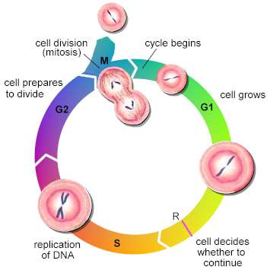

Slide 25
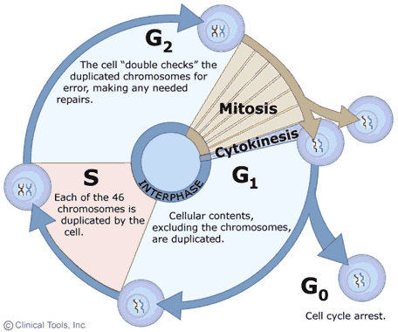

Slide 26
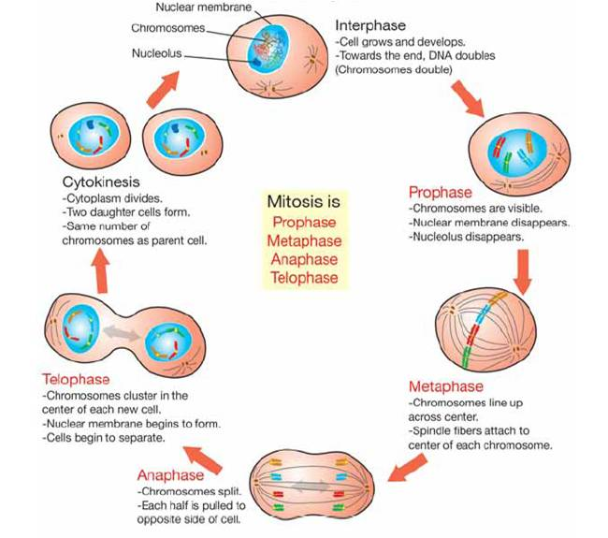

Slide 27
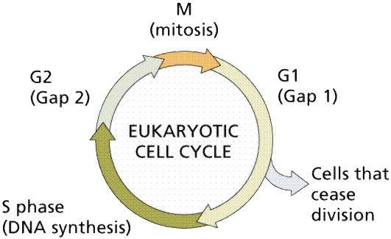

Slide 28
Eukaryotic chromosomes occur in the cell in greater numbers than prokaryotic chromosomes. The condensed replicated chromosomes have several points of interest. The kinetochore is the point where microtubules of the spindle apparatus attach. Replicated chromosomes consist of two molecules of DNA (along with their associated histone proteins) known as chromatids. The area where both chromatids are in contact with each other is known as the centromere. The kinetochores are on the outer sides of the centromere. Remember that chromosomes are condensed chromatin (DNA plus histone proteins).

Slide 29
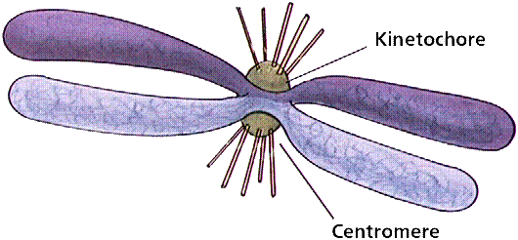
Eukaryotic-chromosome

Slide 30
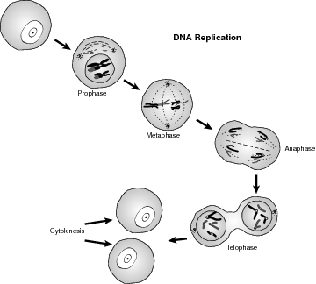

Slide 31
Preprophase
In plant cells only, prophase is preceded by a pre-prophase stage. In highly vacuolated plant cells, the nucleus has to migrate into the center of the cell before mitosis can begin. This is achieved through the formation of a phragmosome, a transverse sheet of cytoplasm that bisects the cell along the future plane of cell division. In addition to phragmosome formation, preprophase is characterized by the formation of a ring of microtubules and actin filaments (called preprophase band) underneath the plasma membrane around the equatorial plane of the future mitotic spindle. This band marks the position where the cell will eventually divide. The cells of higher plants (such as the flowering plants) lack centrioles; instead, microtubules form a spindle on the surface of the nucleus and are then organized into a spindle by the chromosomes themselves, after the nuclear membrane dissolves The preprophase band disappears during nuclear membrane dissolution and spindle formation in prometaphase.

Slide 32
Prophase Normally, the genetic material in the nucleus is in a loosely bundled coil called chromatin. At the onset of prophase, chromatin fibers become tightly coiled, condensing into discrete chromosomes. It is crucial for the reader to note that chromatin is a complex consisting of both chromosomes and specific proteins. Since the genetic material has already been duplicated earlier in S phase, the replicated chromosomes have two sister chromatids, bound together at the centromere by the cohesin protein complex. Chromosomes are typically visible at high magnification through a light microscope.
Also inside the nucleus, the nucleolus in the nucleus disappears from view. This is noteworthy because the cell does not need to divide the nucleolus right away. It will later reform when the nucleus divides completely.

Slide 33
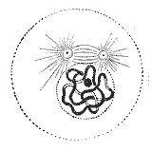
Also inside the nucleus, the nucleolus in the nucleus disappears from view. This is noteworthy because the cell does not need to divide the nucleolus right away. It will later reform when the nucleus divides completely.
Close to the nucleus are structures called centrosomes, consisting of a pair of centrioles, and actin, a halo of microtubule fragments, centrioles are found in most eukaryotic animal cells. The centrosome is the coordinating center for the cell's microtubules. A cell inherits a single centrosome at cell division, which is replicated by the cell with the help of the nucleus before a new mitosis begins, giving a pair of centrosomes. The two centrosomes nucleate microtubules (which may be thought of as cellular ropes or poles) to form the spindle by polymerizing soluble tubulin. Molecular motor proteins then push the centrosomes along these microtubules to opposite sides of the cell. Although centrioles help organize microtubule assembly, they are not essential for the formation of the spindle, since they are absent from plants, and centrosomes are not always used in mitosis.

Slide 34
Prometaphase
*Prometaphase is sometimes included as part of the end of prophase and early metaphase.
*During early prometaphase, the nuclear membrane disintegrates and microtubules invade the nuclear space.
*This is called open mitosis, and it occurs in most multicellular organisms. Fungi and someprotists, such as algae or trichomonads, undergo a variation called closed mitosis where the spindle forms inside the nucleus, or its microtubules are able to penetrate an intact nuclear membrane, which stays intact.

Slide 35
*In late prometaphase, each chromosome forms two kinetochores at its centromere, one attached at each chromatid.
* A kinetochore is a complex protein structure that is analogous to a ring for the microtubule hook; it is the point where microtubules attach themselves to the chromosome ( about 1-40 in number, on an average 20 ).
*Although the kinetochore structure and function are not fully understood, it is known that it contains some form of molecular motor. .

Slide 36
*When a microtubule connects with the kinetochore, the motor activates, using energy from ATP to "crawl" up the tube toward the originating centrosome.
* This motor activity, coupled with polymerisation and depolymerisation of microtubules, provides the pulling force necessary to later separate the chromosome's two chromatids

Slide 37
*When the spindle grows to sufficient length, kinetochore microtubules begin searching for kinetochores to attach to.
* A number of nonkinetochore microtubules find and interact with corresponding nonkinetochore microtubules from the opposite centrosome to form the mitotic spindle.

Slide 38
*Prometaphase is sometimes considered part of prophase.
*In the fishing pole analogy, the kinetochore would be the "hook" that catches a sister chromatid or "fish".
* The centrosome acts as the "reel" that draws in the spindle fibers or "fishing line". *It is also one of the main phases of mitosis because without it cytokinesis would not be able to occur.

Slide 39
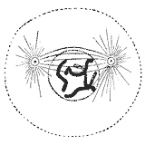
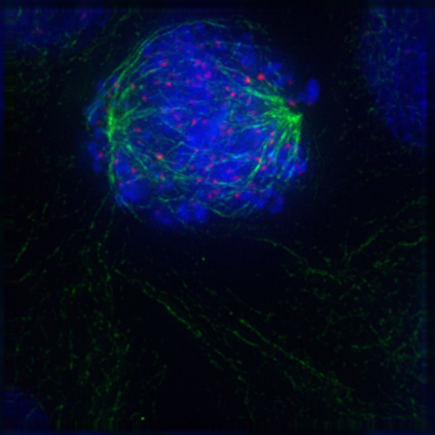
PROMETAPHASE

Slide 40
Metaphase
*A cell in late metaphase. All chromosomes (blue) but one have arrived at the metaphase plate.
*Metaphase comes from the Greek μετα meaning "after." Microtubules find and attach to kinetochores in prometaphase.
*Then the two centrosomes start pulling the chromosomes through their attached centromeres towards the two ends of the cell.
As a result, the chromosomes come under longitudinal tension from the two ends of the cell.
*The centromeres of the chromosomes, in some sense, convene along the metaphase plate or equatorial plane, an imaginary line that is equidistant from the two centrosome poles.

Slide 41
This line is called the spindle equator. This even alignment is due to the counterbalance of the pulling powers generated by the opposing kinetochores, analogous to a tug-of-war between people of equal strength. In certain types of cells, chromosomes do not line up at the metaphase plate and instead move back and forth between the poles randomly, only roughly lining up along the midline.

Slide 42
Because proper chromosome separation requires that every kinetochore be attached to a bundle of microtubules (spindle fibres), it is thought that unattached kinetochores generate a signal to prevent premature progression to anaphase without all chromosomes being aligned. The signal creates the mitotic spindle checkpoint

Slide 43
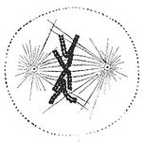
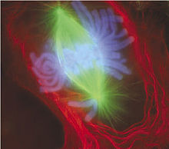
METAPHASE

Slide 44
Anaphase
When every kinetochore is attached to a cluster of microtubules and the chromosomes have lined up along the metaphase plate, the cell proceeds to anaphase (from the Greek ανα meaning “up,” “against,” “back,” or “re-”).
Two events then occur: first, the proteins that bind sister chromatids together are cleaved. These sister chromatids now become separate daughter chromosomes, and are pulled apart by shortening kinetochore microtubules and move toward the respective centrosomes to which they are attached.

Slide 45
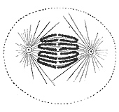
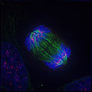
ANAPHASE

Slide 46
Telophase
*Telophase (from the Greek τελος meaning "end") is a reversal of prophase and prometaphase events. It "cleans up" the after effects of mitosis.
*At telophase, the polar microtubules continue to lengthen, elongating the cell even more. *Corresponding daughter chromosomes attach at opposite ends of the cell.
*A new nuclear membrane, using the membrane vesicles of the parent cell's old nuclear membrane, forms around each set of separated daughter chromosomes. (the membrane does not enclose the centrosome, though!)

Slide 47
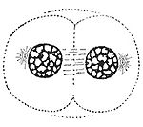
The nucleoli reappear, too. Both sets of chromosomes, now surrounded by new nuclei, begin to "relax" or decondense back into chromatin. Mitosis is complete, but cell division is not yet complete.

